Slide 1
Chapter 2: Operating-System Structures
March 8, 2021

Slide 2
Chapter 2: Operating-System Structures
Multi-programming and Time-sharing
time
System Boot
System Services
System Call
User mode vs. kernel mode
OS design, implementation, structure, debug
Micro-kernel

Slide 3
Objectives
To review interrupt
To explain how operating systems are installed and how they boot
To describe the services an operating system provides to users, processes, and other systems
System call
To discuss the various ways of structuring an operating system

Slide 4
Review
Operating system is _____ driven
Interrupt handling

Slide 5
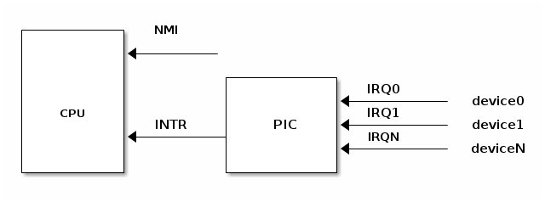
Interrupt
External
Internal: e.g.
Notes:
https://linux-kernel-labs.github.io/master/lectures/interrupts.html

Slide 6
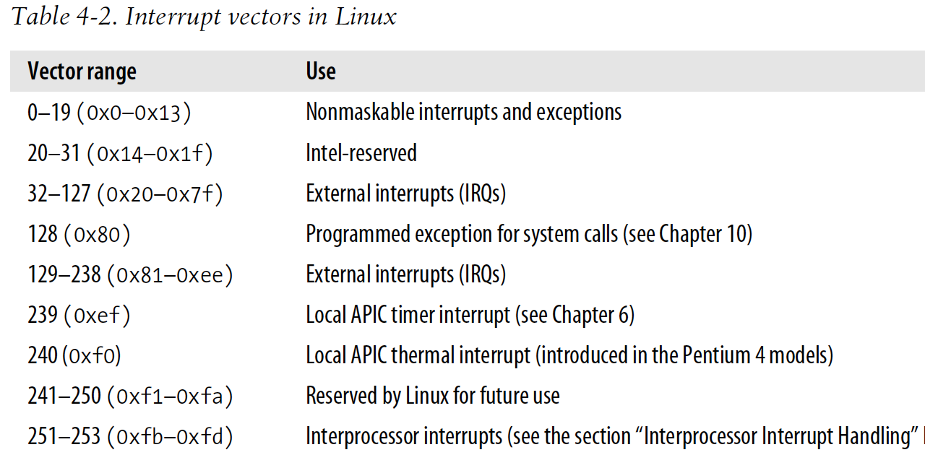
Interrupt Vector for Linux 2.6

Slide 7
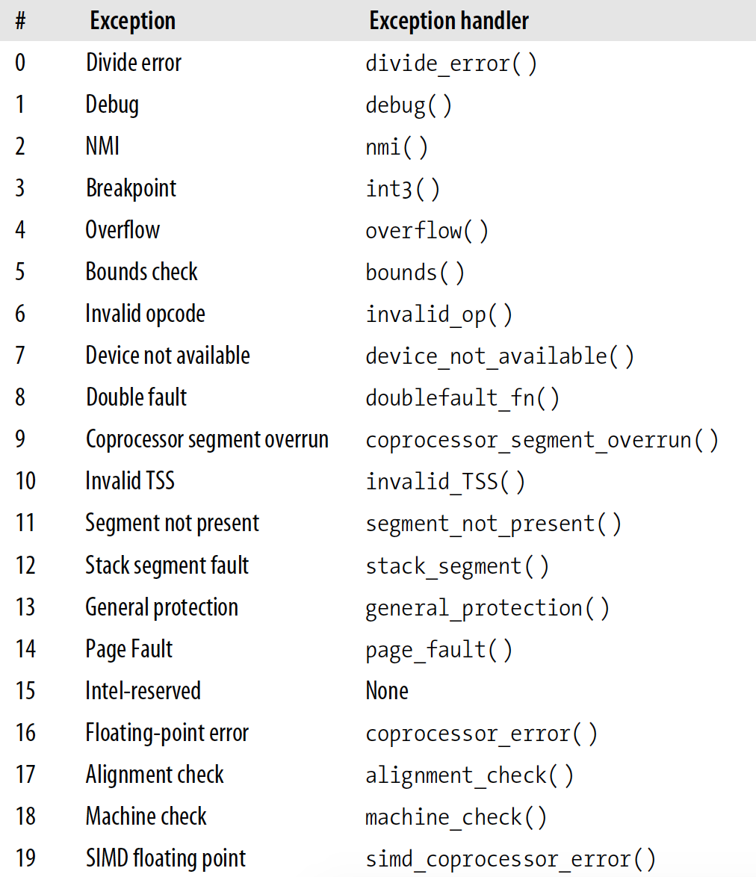
Interrupt Vector for Linux 2.6

Slide 8
Multiprogramming
Multiprogramming needed for efficiency
Single user cannot keep CPU and I/O devices busy at all times
Multiprogramming organizes jobs (code and data) so CPU always has one to execute
A subset of total jobs in system is kept in memory
One job selected and run via job scheduling
When it has to wait (for I/O for example), OS switches to another job
Timesharing is logical extension in which CPU switches jobs so frequently that users can interact with each job while it is running, creating interactive computing
Response time should be < 1 second
Each user has at least one program executing in memory  process
If several jobs ready to run at the same time  CPU scheduling
Notes:
一边听音乐一边写作业

Slide 9
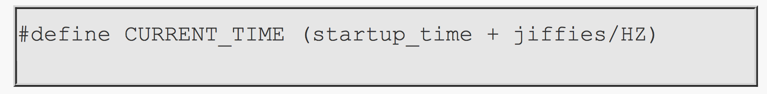
Time/Timer
Timer interrupt
HZ
jiffies: number of timer interrupts from boot
CMOS: RTC (real time clock)
UNIX time： the number of seconds that have elapsed since 00:00:00 January 1st, 1970
Notes:
cat /boot/config-`uname -r` | grep '^CONFIG_HZ='
date +%s
The year 2038
2019.03.04: 1551640580
2020.03.04: 1583317788
The year 2038: 2147483647

Slide 10
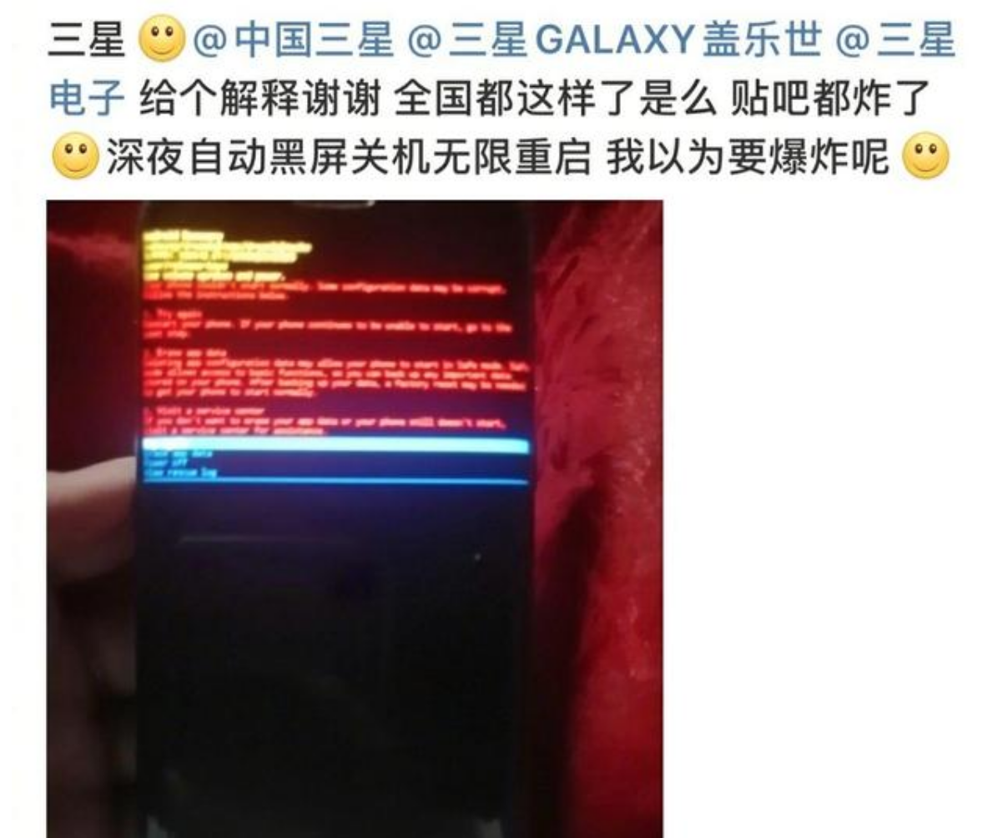
Time Bug？
2020.05.23
Notes:
cat /boot/config-`uname -r` | grep '^CONFIG_HZ='
date +%s
The year 2038
2019.03.04: 1551640580
2020.03.04: 1583317788
2021.03.08: 1615198954
The year 2038: 2147483647

Slide 11
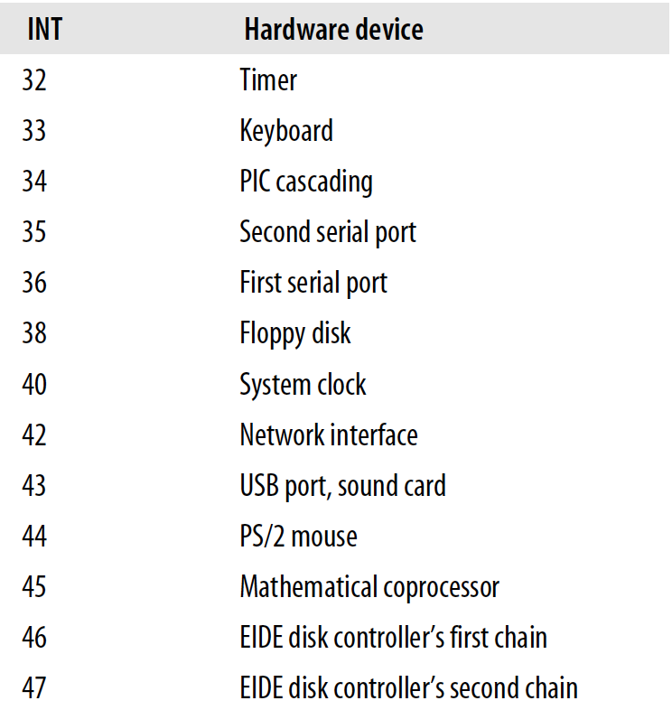
Interrupt Vector for Linux 2.6
Notes:
操作系统的脉搏

Slide 12
Summary of Interrupt
The fundamental axiom here is that at any given moment, exactly one task is active on a CPU. Not two or more. Never zero, either. One. Always.
Cited from https://manybutfinite.com/post/when-does-your-os-run/
That's where interrupts come in.

Slide 13
The Boot Process

Slide 14
System Boot
BIOS (Basic Input-Output System)
UEFI
POST (power-on self-test)
First sector: MBR (master boot recorder), partition table
For linux: Grub
Notes:
加电－CPU－ROM－BIOS－System Clock－DMA－64KB RAM－IRQ－显卡等。检测显卡以前的过程称过关键部件测试，如果关键部件有问题，计算机会处于挂起状态，习惯上称为核心故障。另一类故障称为非关键性故障，检测完显卡后，计算机将对64KB以上内存、I／O口、软硬盘驱动器、键盘、即插即用设备、CMOS设置等进行检测，并在屏幕上显示各种信息和出错报告。在正常情况下，POST过程进行得非常快，我们几乎无法感觉到这个过程。

Slide 15
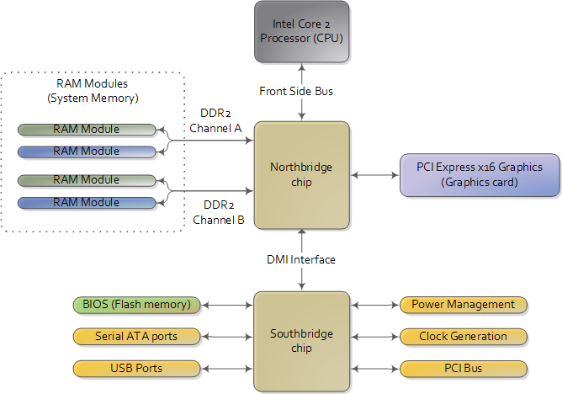
Motherboard Chipset
Pictures:
http://duartes.org/gustavo
/blog/archives/
Notes:
Switch computer???

Slide 16
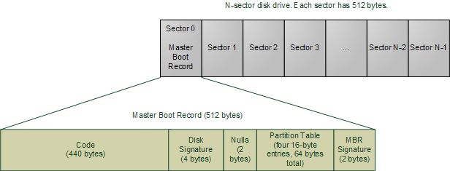
MBR Structure
Pictures: http://duartes.org/gustavo/blog/archives/

Slide 17
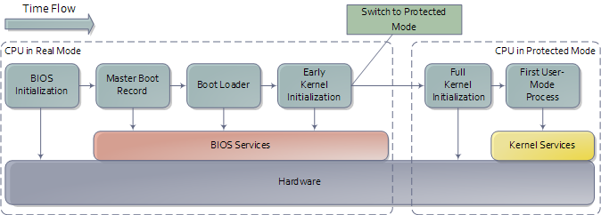
Boot Process
Control of CPU

Slide 18
System Services

Slide 19
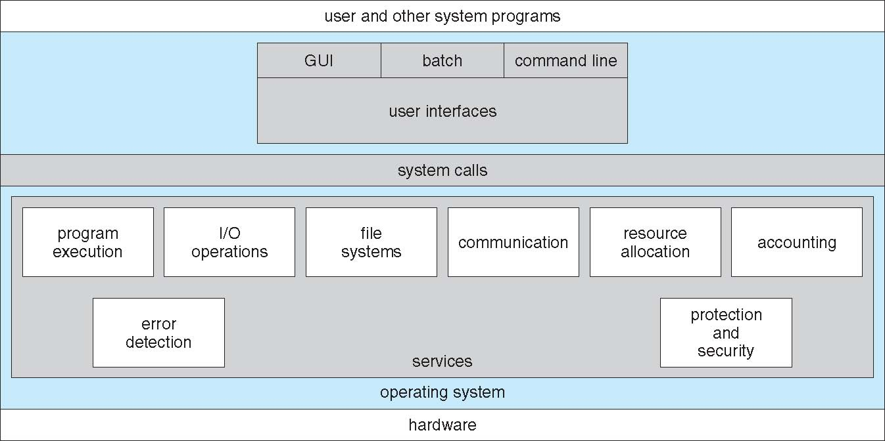
A View of Operating System Services

Slide 20
User Operating System Interface - CLI
CLI or command interpreter allows direct command entry
Sometimes implemented in kernel, sometimes by systems program
Sometimes multiple flavors implemented – shells
Primarily fetches a command from user and executes it
Sometimes commands built-in, sometimes just names of programs
If the latter, adding new features doesn’t require shell modification

Slide 21
User Operating System Interface - GUI
User-friendly desktop metaphor interface
Usually mouse, keyboard, and monitor
Icons represent files, programs, actions, etc
Various mouse buttons over objects in the interface cause various actions (provide information, options, execute function, open directory (known as a folder)
Invented at Xerox PARC
Many systems now include both CLI and GUI interfaces
Microsoft Windows is GUI with CLI “command” shell
Apple Mac OS X is “Aqua” GUI interface with UNIX kernel underneath and shells available
Unix and Linux have CLI with optional GUI interfaces (CDE, KDE, GNOME)

Slide 22
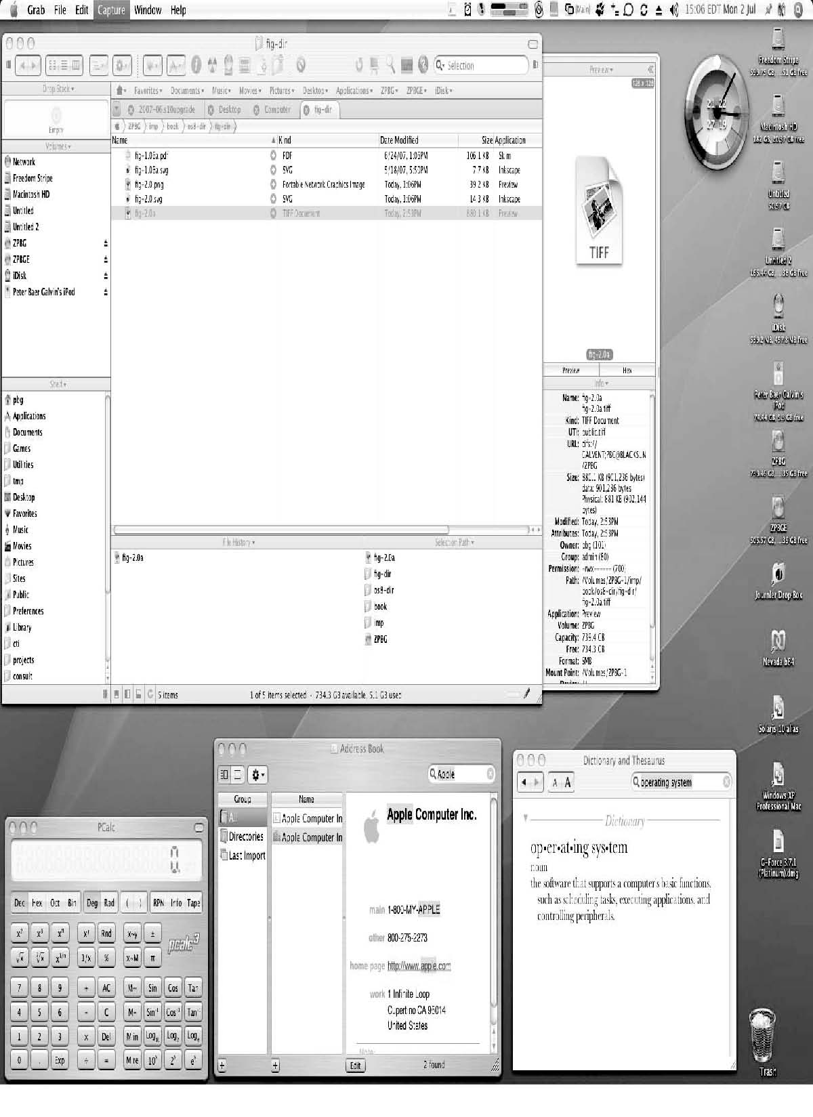
The Mac OS X GUI

Slide 23
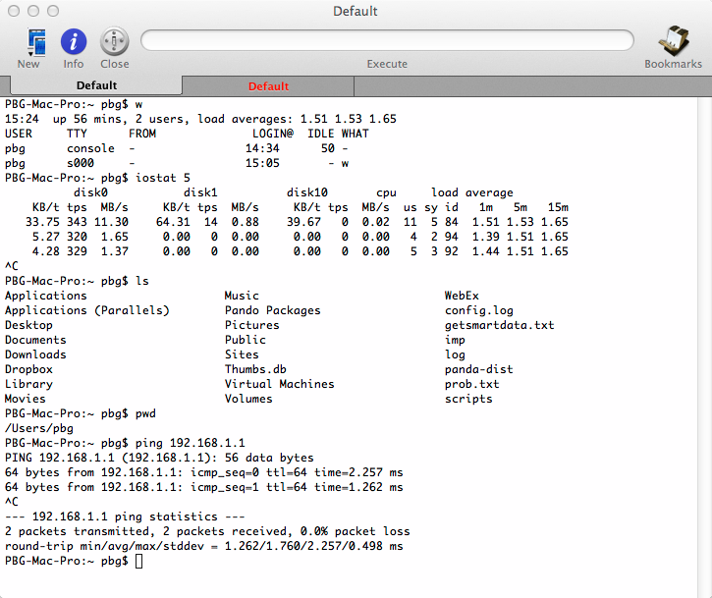
MacOS
demo

Slide 24
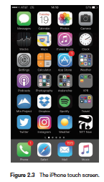
Touchscreen Interfaces
Touchscreen devices require new interfaces
Mouse not possible or not desired
Actions and selection based on gestures
Virtual keyboard for text entry
Voice commands.

Slide 25
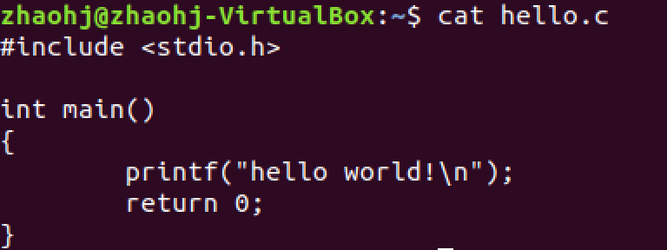
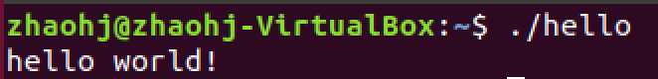
C Program： Hello World
API
Notes:
For programmers, interfaces are APIs

Slide 26
Dual Mode

Slide 27
Protected Mode
Control of CPU
real
protected

Slide 28
C Program： Hello World
API
Notes:
从使用的方便角度
从使用的安全角度

Slide 29
Operating-System Operations (cont.)
Dual-mode operation allows OS to protect itself and other system components
User mode and kernel mode
Mode bit provided by hardware
Provides ability to distinguish when system is running user code or kernel code
Some instructions designated as privileged, only executable in kernel mode

Slide 30
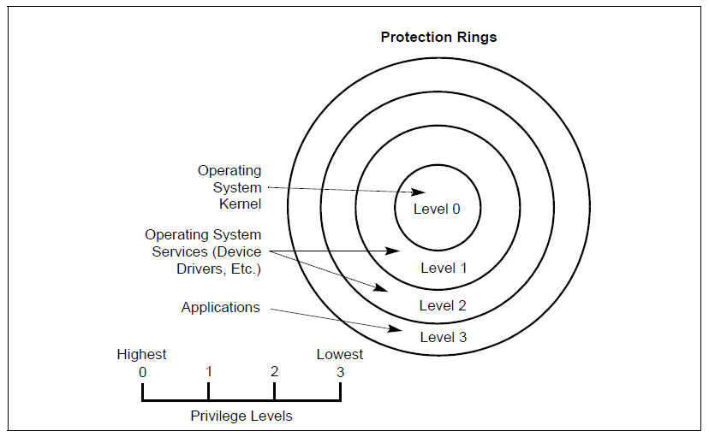
CPU Protection Ring

Slide 31
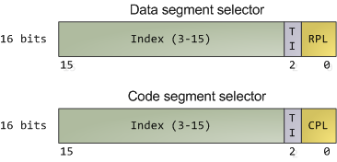
CPU Protection Ring
Pictures: http://duartes.org/gustavo/blog/archives/

Slide 32
System Call

Slide 33
C Program： Hello World
API
Notes:
从使用的方便角度
从使用的安全角度

Slide 34
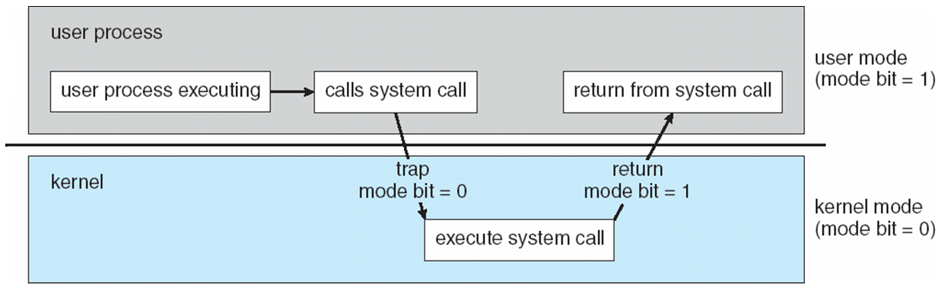
Transition from User to Kernel Mode

Slide 35
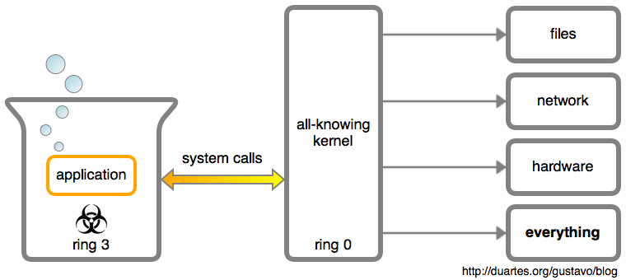
System Calls

Slide 36
System Calls
Programming interface to the services provided by the OS
Typically written in a high-level language (C or C++)
Mostly accessed by programs via a high-level Application Programming Interface (API) rather than direct system call use
printf()
read()
write()

Slide 37
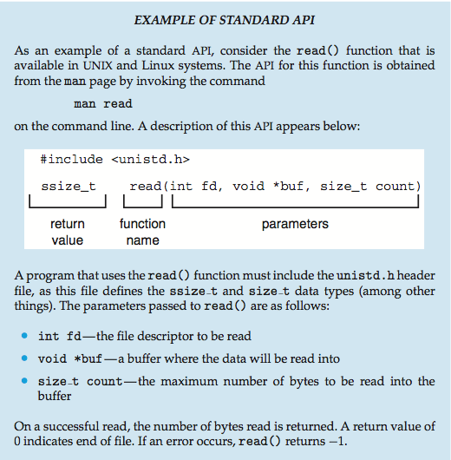
Example of Standard API
Notes:
Give an example: strace ./a.out %%hello world!
ltrace ./a.out

Slide 38
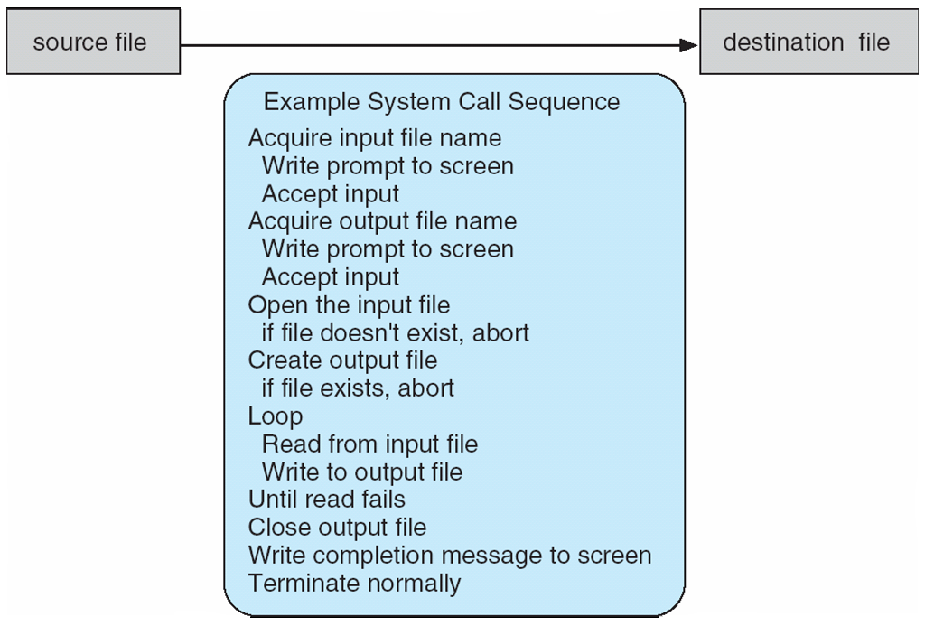
Example of System Calls
System call sequence to copy the contents of one file to another file

Slide 39
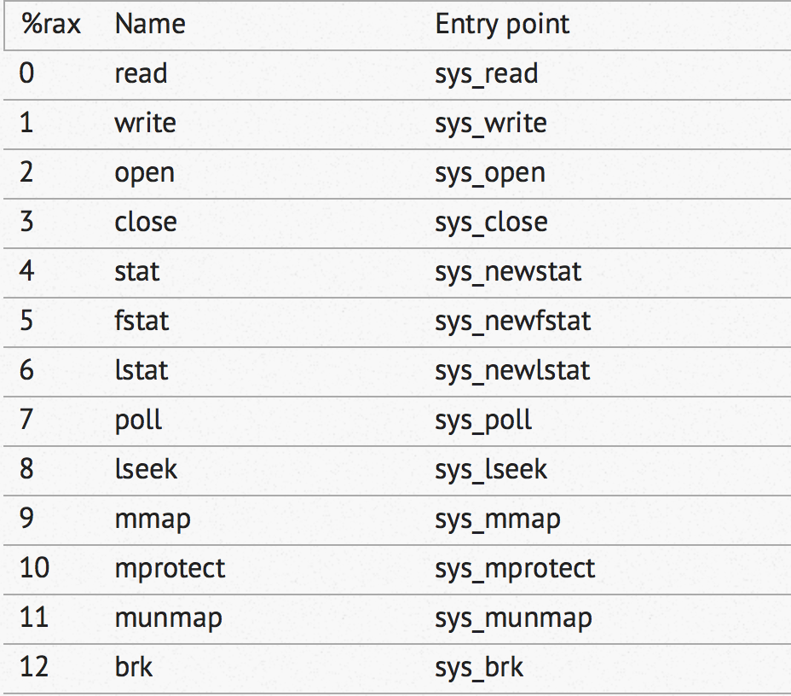
Linux System Call List
Notes:
https://github.com/torvalds/linux/blob/v3.17/arch/x86/syscalls/syscall_64.tbl
More than 500

Slide 40
System Call Implementation

Slide 41
Interrupt Vector for Linux
May be obsolete

Slide 42
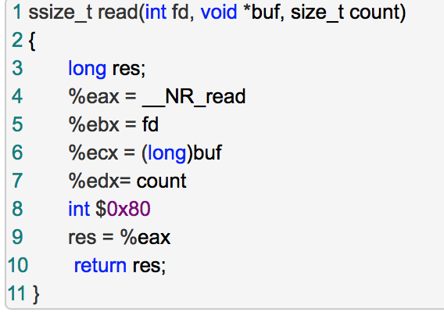
Read Wrapper
Notes:
#define __NR_read 3
//这种实现方式是否陈旧？
Syscall? Sysenter?

Slide 43
Summary
read():
int 0x80
sys_read
Interrupt vector table: 0x80
system_call:
system call NO.

Slide 44
System Call Parameter Passing
Often, more information is required than simply identity of desired system call
Exact type and amount of information vary according to OS and call
Three general methods used to pass parameters to the OS
Simplest: pass the parameters in registers
In some cases, may be more parameters than registers
Parameters stored in a block, or table, in memory, and address of block passed as a parameter in a register
This approach taken by Linux and Solaris
Parameters placed, or pushed, onto the stack by the program and popped off the stack by the operating system
Block and stack methods do not limit the number or length of parameters being passed

Slide 45
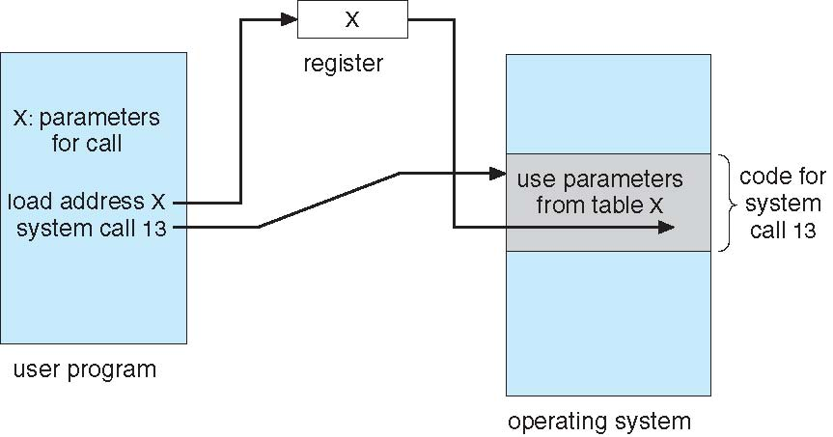
Parameter Passing via Table

Slide 46
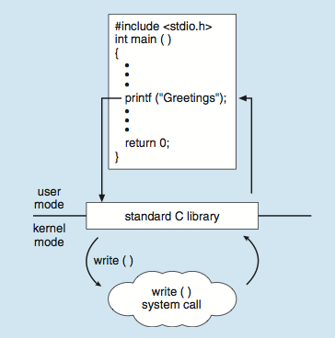
API – System Call – OS Relationship
C program invoking printf() library call, which calls write()
Notes:
Give an example: strace hello world

Slide 47
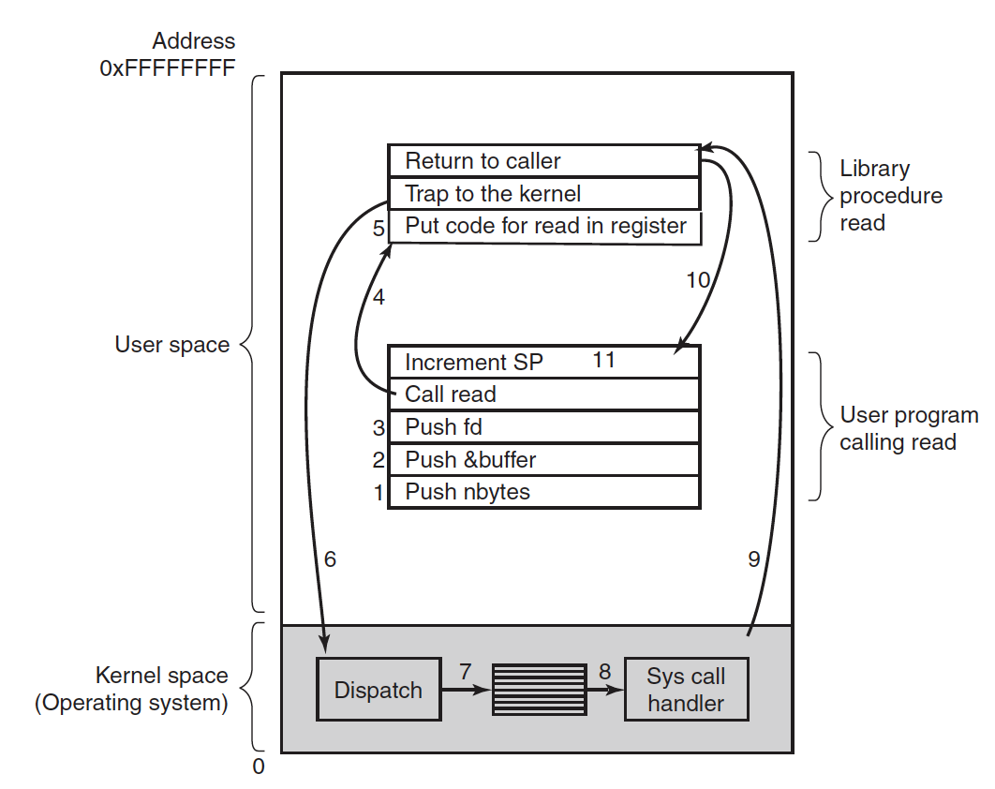
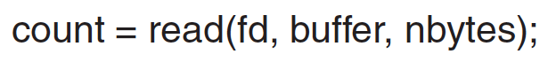
Notes:
!!!: read wrapper
!!!: stack (kernel???)

Slide 48
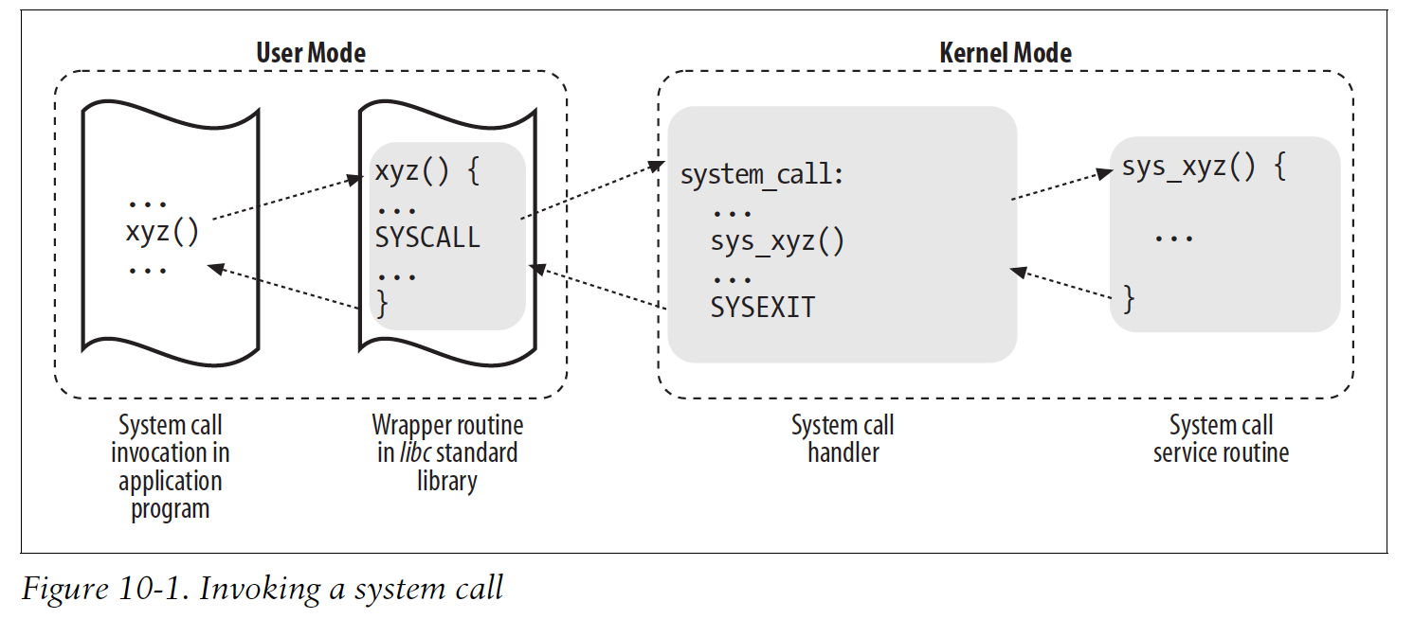
System Call: Summary

Slide 49
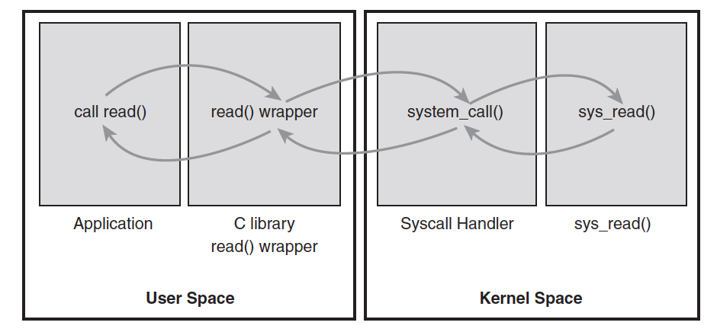
System Call: Summary

Slide 50
Summary: Interrupt Driven
Interrupt driven (hardware and software)
Hardware interrupt by one of the devices
Software interrupt (exception or trap):
Software error (e.g., division by zero)
Request for operating system service
Other process problems include infinite loop, processes modifying each other or the operating system

Slide 51
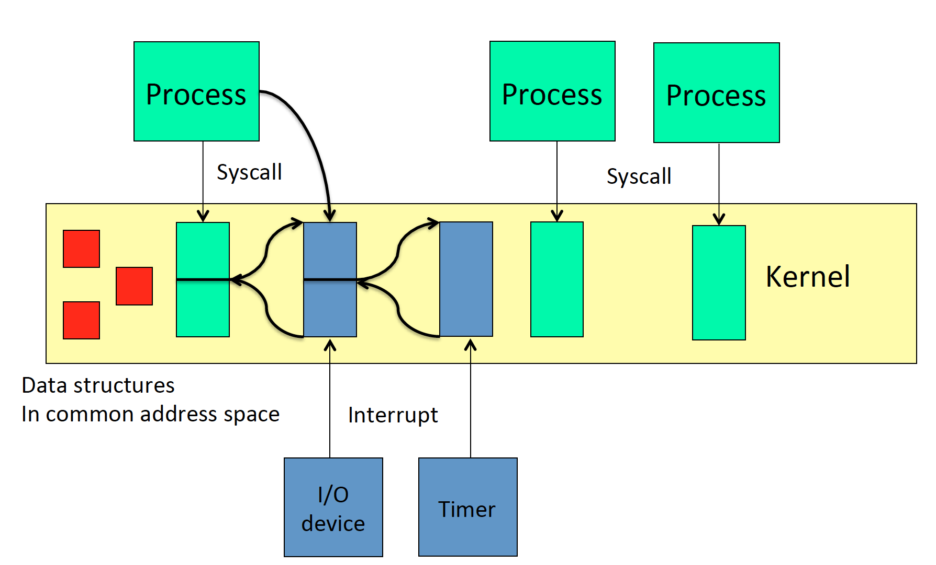
Summary: Interrupt Driven

Slide 52
Types of System Calls
Process control
create process, terminate process
end, abort
load, execute
get process attributes, set process attributes
wait for time
wait event, signal event
allocate and free memory
Dump memory if error
Debugger for determining bugs, single step execution
Locks for managing access to shared data between processes

Slide 53
Types of System Calls
File management
create file, delete file
open, close file
read, write, reposition
get and set file attributes
Device management
request device, release device
read, write, reposition
get device attributes, set device attributes
logically attach or detach devices

Slide 54
Types of System Calls (Cont.)
Information maintenance
get time or date, set time or date
get system data, set system data
get and set process, file, or device attributes
Communications
create, delete communication connection
send, receive messages if message passing model to host name or process name
From client to server
Shared-memory model create and gain access to memory regions
transfer status information
attach and detach remote devices

Slide 55
Types of System Calls (Cont.)
Protection
Control access to resources
Get and set permissions
Allow and deny user access

Slide 56
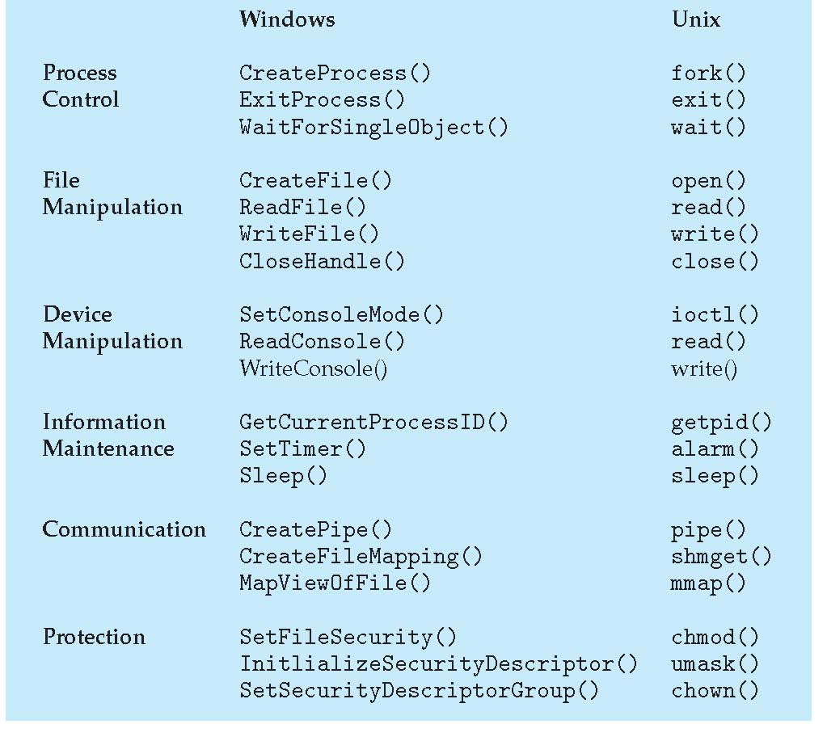
Examples of Windows and Unix System Calls

Slide 57
Question
Why Applications Are Operating-System Specific?
Demo 1: hello world
Demo 2: vscode download
https://code.visualstudio.com/#alt-downloads
Notes:
https://code.visualstudio.com/#alt-downloads
The ‘file ***’ command in Linux
https://code.visualstudio.com/Download
Reasons are:
Instruction set
Executable file format
Dynamically linked library
System call

Slide 58
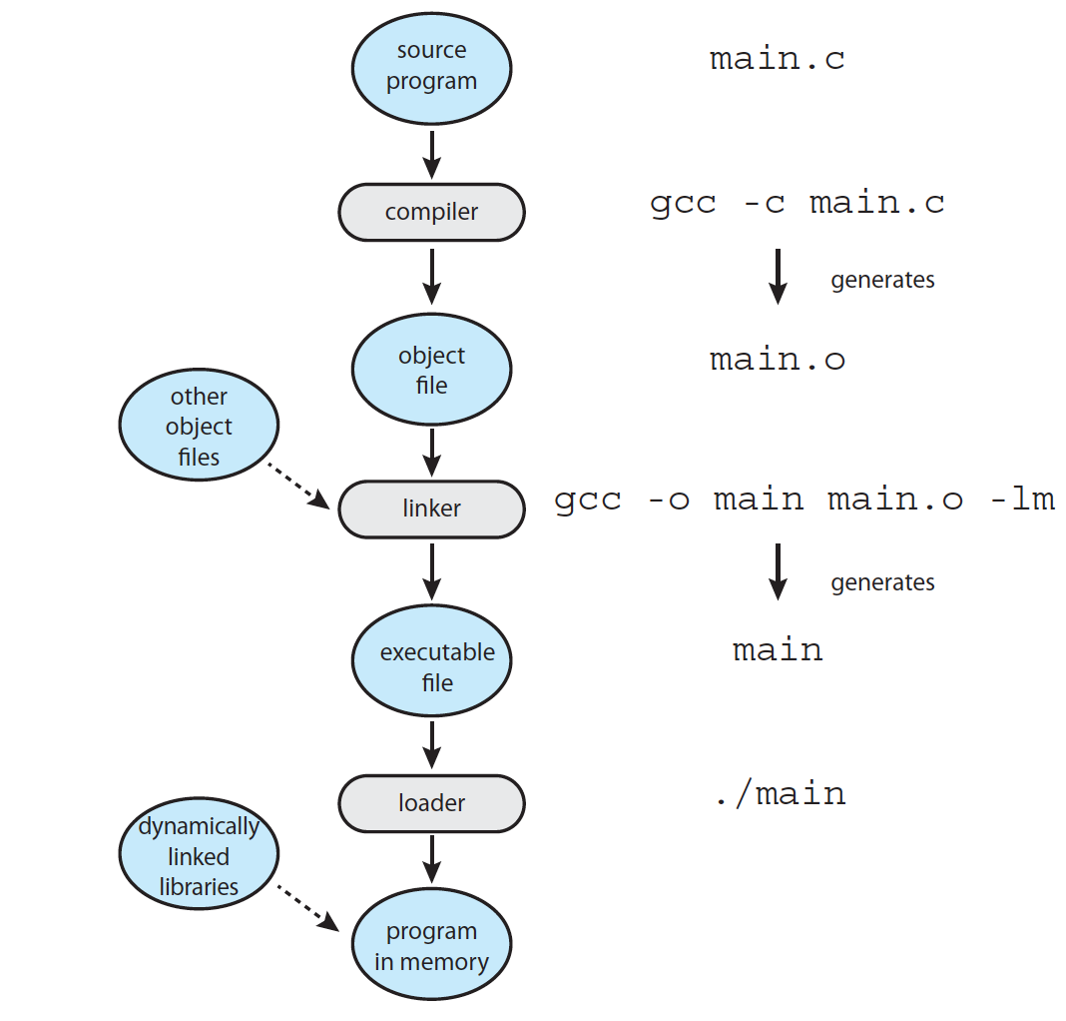
Linker and Loader
Notes:
Dynamically linked library

Slide 59
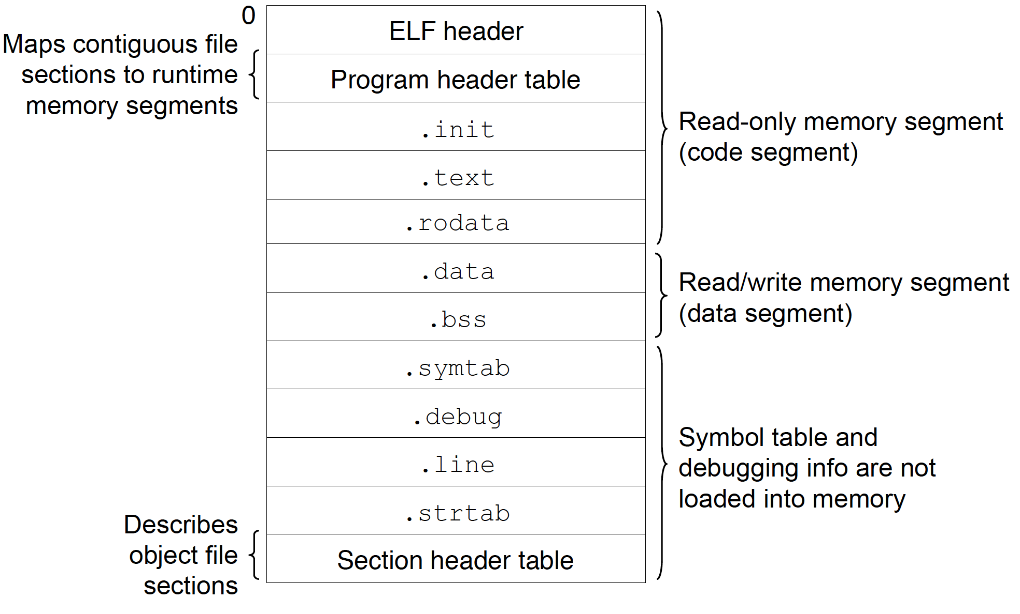
Executable Binary for Linux
Notes:
Executable file format

Slide 60
Operating System Structure

Slide 61
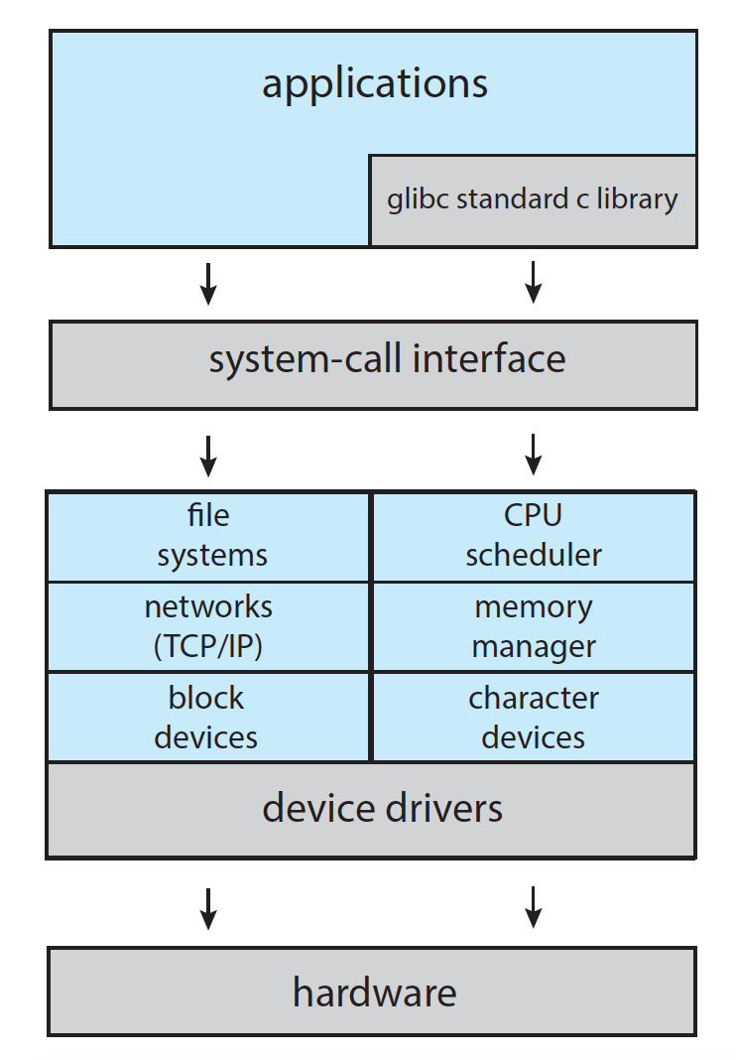
Monolithic: Linux
Demo1
Demo2
Notes:
C:\Windows\System32\ntoskrnl.exe
\boot\vmlinuz-4.4.0-31-generic
\boot\vmlinuz-5.3.0-40-generic (18.04.4)
ls -lh

Slide 62
Microkernel System Structure

Slide 63
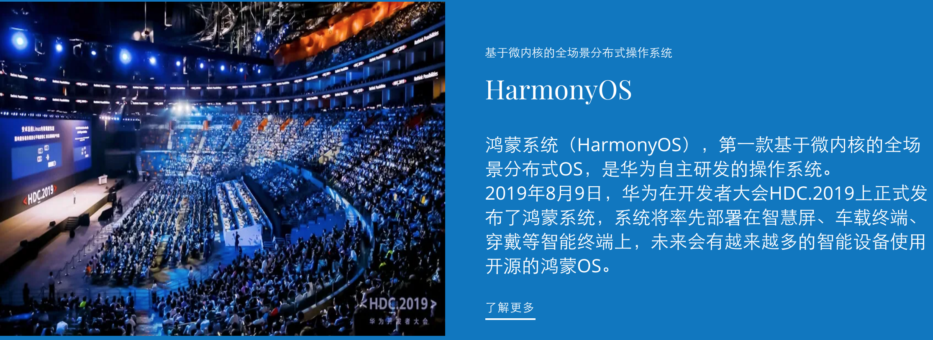
Harmony OS
微内核、全场景、分布式
https://hmxt.org/

Slide 64
Loadable Modules
Many modern operating systems implement loadable kernel modules
Uses object-oriented approach
Each core component is separate
Each talks to the others over known interfaces
Each is loadable as needed within the kernel
Overall, similar to layers but with more flexible
Linux, Solaris, etc

Slide 65
Summary
Multi-programming and Time-sharing
time
System Boot
System Services
System Call
User mode vs. kernel mode
OS design, implementation, structure, debug
Micro-kernel

Slide 66
End of Chapter 2

